Slide 1
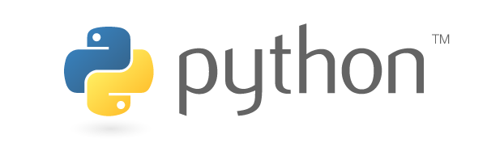
Set up new Python interpreter

Slide 2
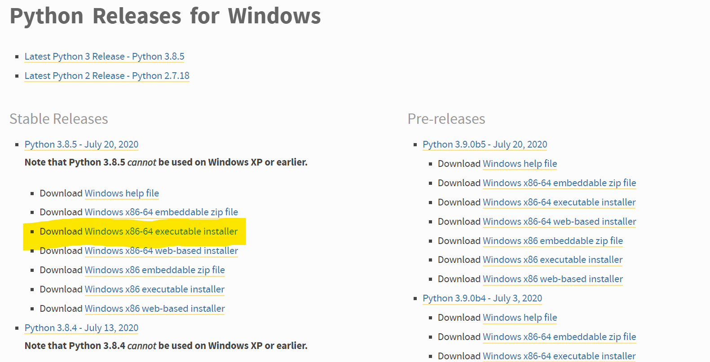
1st step
Download desired Python from https://www.python.org/downloads/windows/
Notice to download the executable distribution as marked

Slide 3
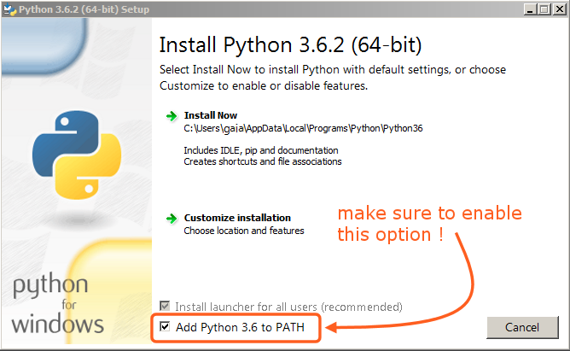
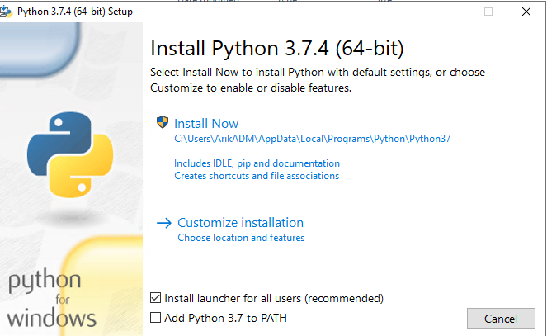
2nd step
Make sure to check those following boxes:
Then, click on ‘Customize installation’

Slide 4
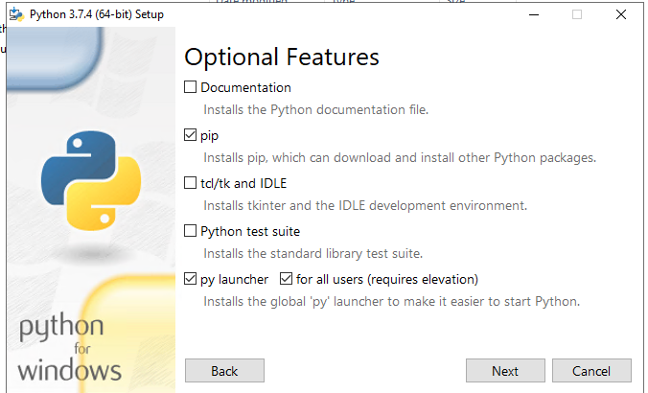
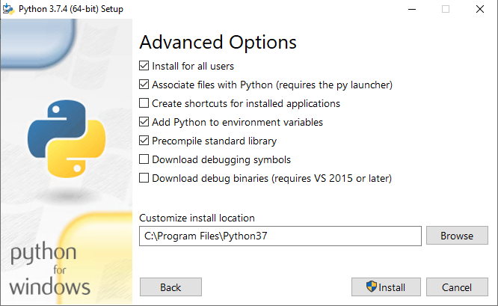
3rd Step
Make sure to check all the following boxes:

Slide 5
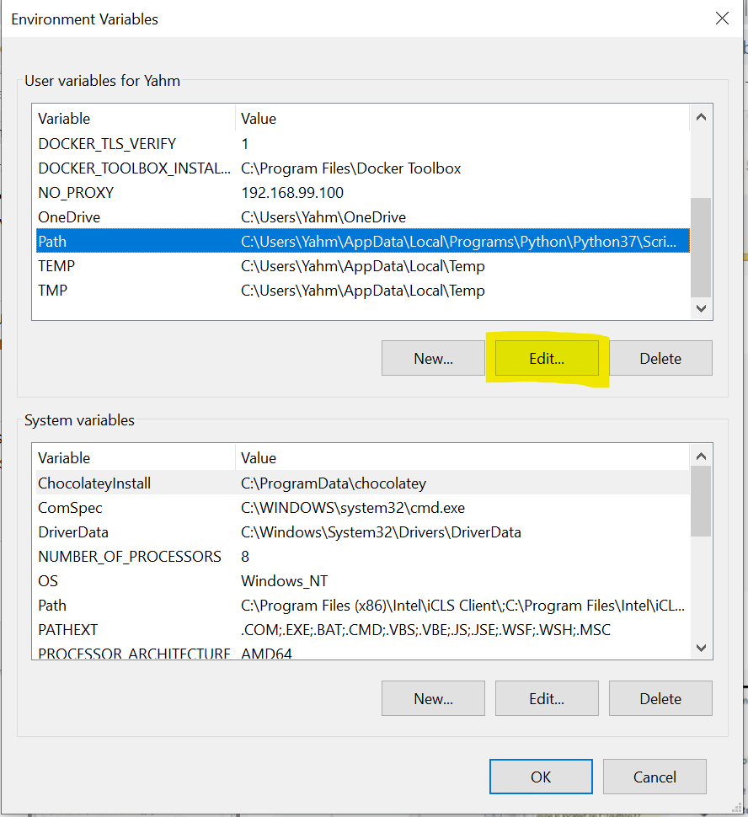
4th step
Enter ‘Environment Variables‘ and click ‘Edit’
at ‘Path’

Slide 6
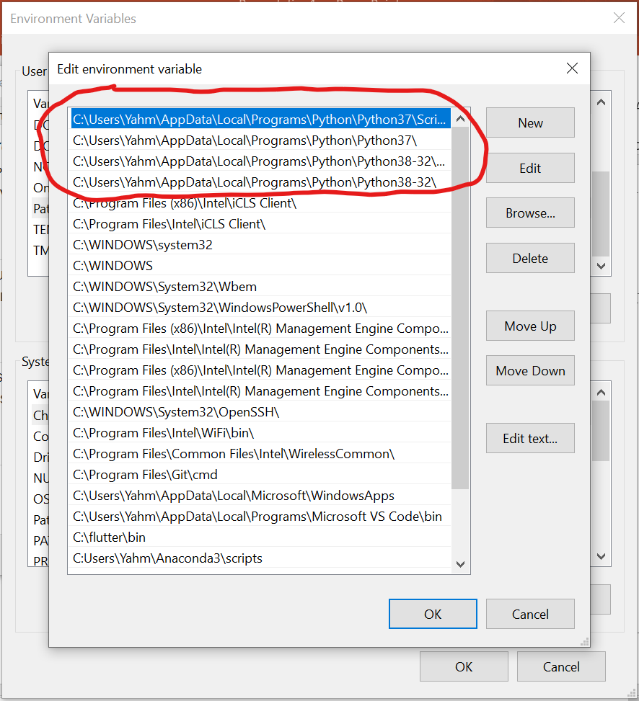
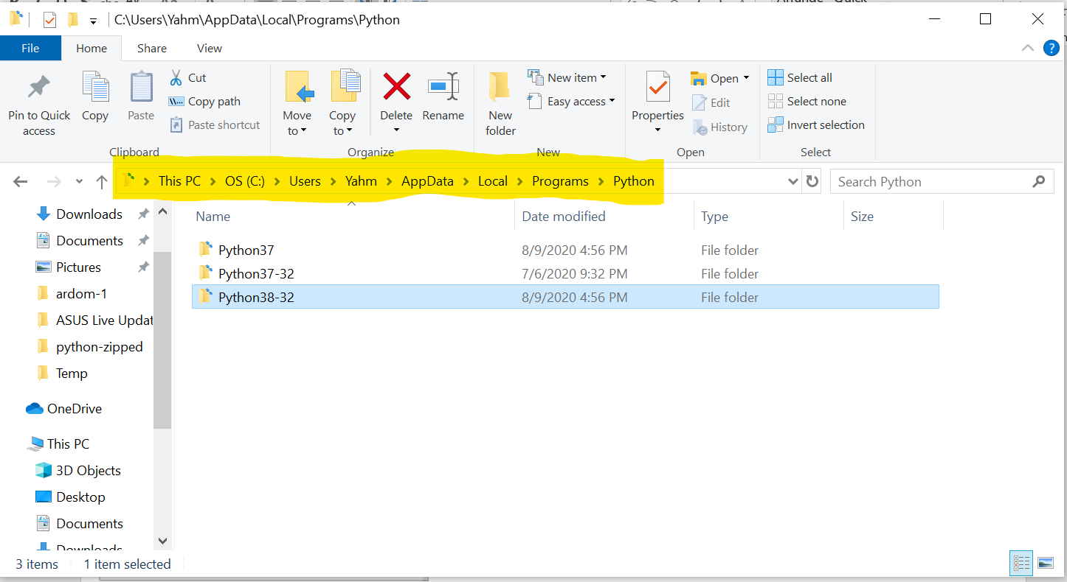
5th step
You will be able to see where Python is installed – open the newly installed Python folder

Slide 7
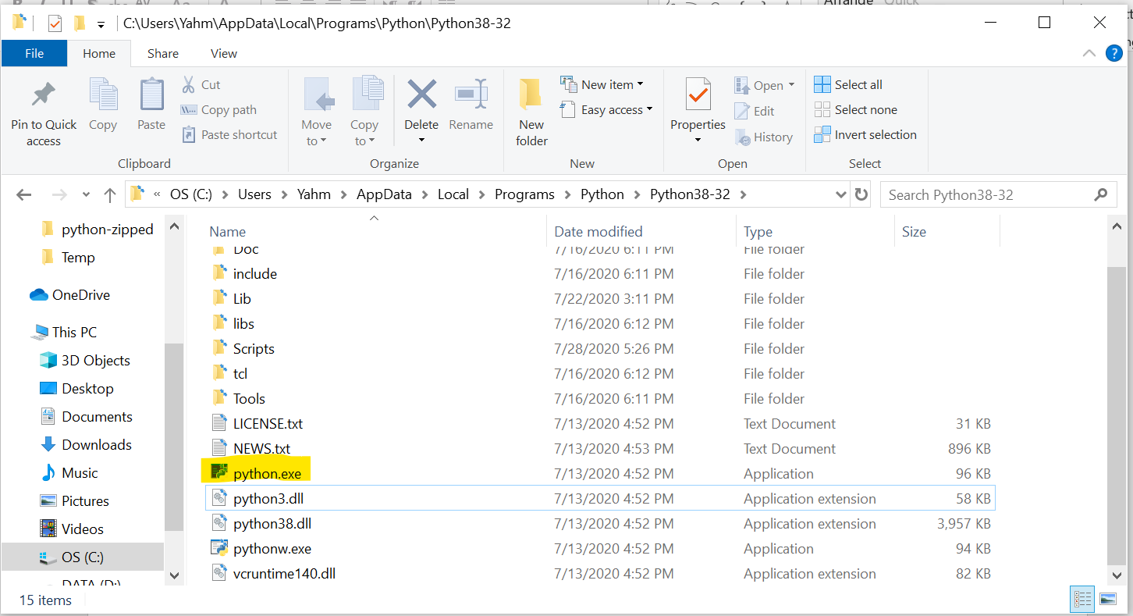
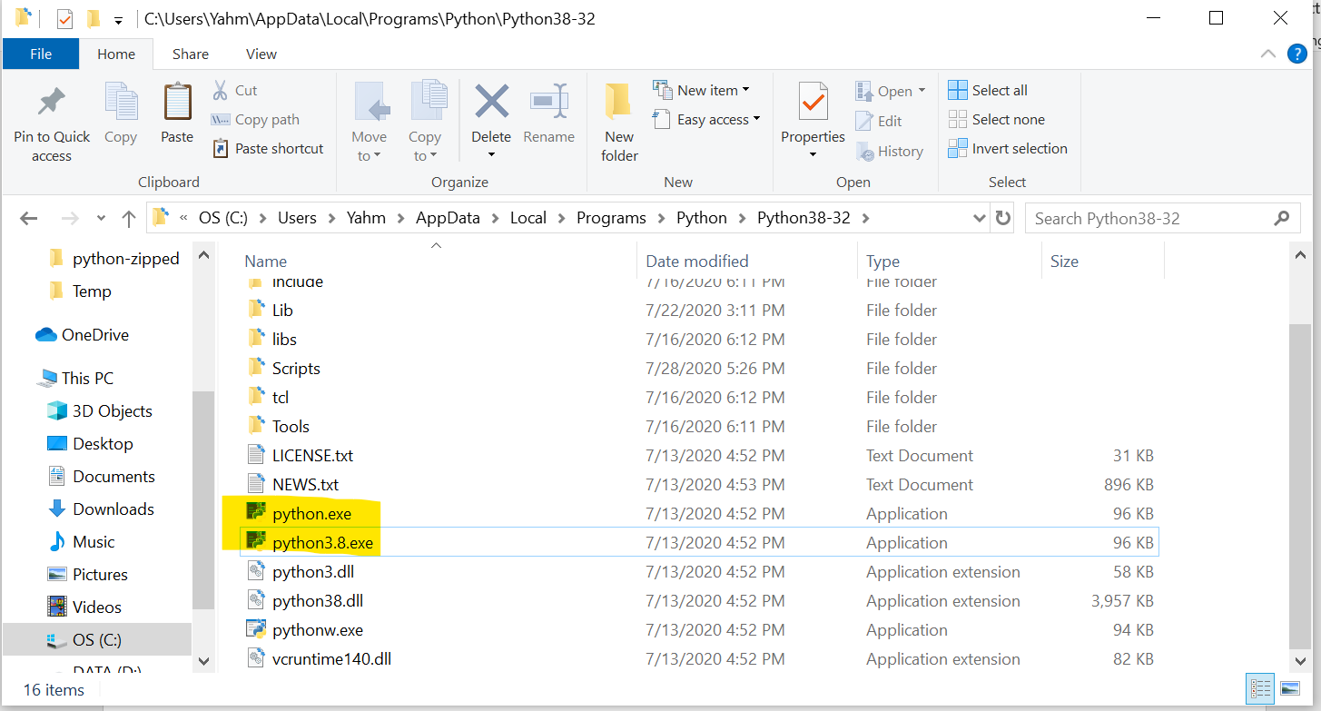
6th step
Duplicate ‘python.exe’ file and rename the new one pythonX.X.exe (python + version number)

Slide 8
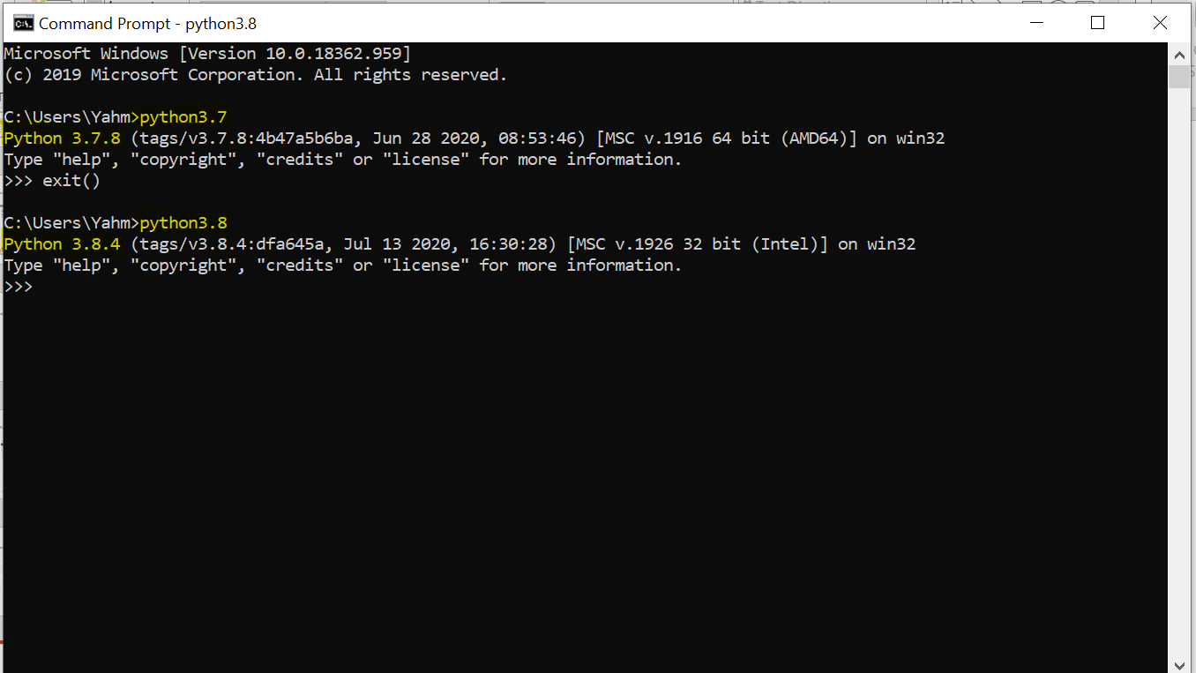
7th step
Access Python as needed!

